Slide 1
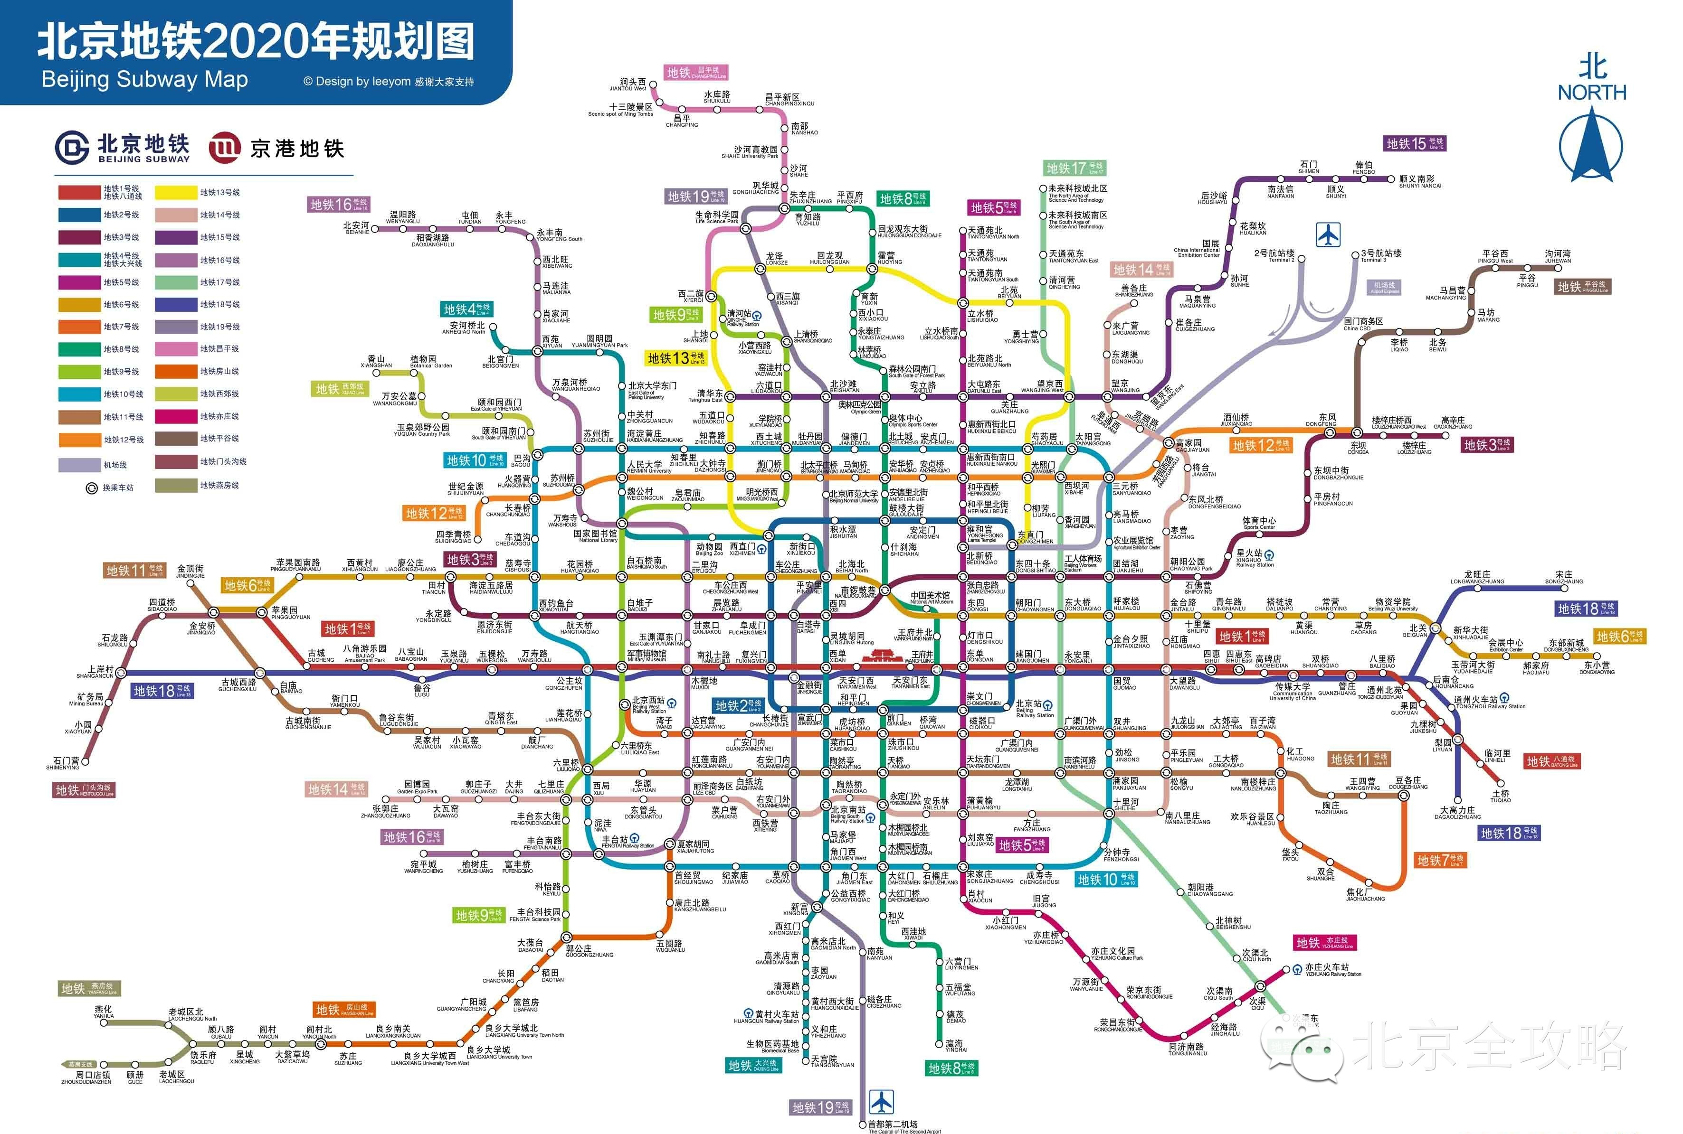
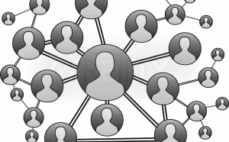
Topic 7: Graphs
COMP2014J: Data Structures and Algorithms 2
Dr. David Lillis (david.lillis@ucd.ie)
Beijing-Dublin International College
Further Reading: Goodrich and Tamassia (6th Edition), Section 14.1 & 14.2

Slide 2
Introduction to Graphs
A graph consists of a number of vertices (singular: vertex) that can be linked by a number of edges.
An edge represents a connection between two vertices.
There are many examples of data that can be modeled using graphs.
Subway Map: stations are vertices, the edges represent rail track between stations.
Social Network: users are vertices, edges represent that they are friends (or that one user follows another).
Airline route maps: airports are vertices, edges represent that they are linked by a flight.

Slide 3
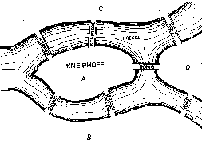
Origin of Graph Theory
It is thought that the theory of graphs began with a problem in the city of Konigsberg:
Is it possible to walk through the city so that you cross each bridge exactly once?

Slide 4
Origin of Graph Theory
The famous Swiss mathematician Leonhard Euler realised that for this problem there was no difference between different parts of the same land mass.
The bridges just connected land masses.

Slide 5
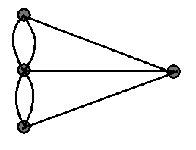
Origin of Graph Theory
Euler simplified the problem to use points (vertices) to represent land masses, and lines (edges) to represent bridges.
From this, it was easy to prove that it was not possible to pass over each bridge once.
C
A
D
B

Slide 6
Other Applications
Electronic circuits
Printed circuit board
Integrated circuit
Transportation networks
Highway network
Flight network
Computer networks
Local area network
Internet
Web
Databases
Entity-relationship diagram

Slide 7
Graphs
A graph is a pair (V, E), where
V is a set of nodes, called vertices
E is a collection of pairs of vertices, called edges
Vertices and edges are nodes and store elements
Example:
A vertex represents an airport and stores the three-letter airport code
An edge represents a flight route between two airports and stores the distance of the route
849
PVD
1843
ORD
142
SFO
802
LGA
337
1743
1387
HNL
2555
1099
LAX
1233
DFW
1120
MIA

Slide 8
Edge Types
Directed edge
ordered pair of vertices (u,v)
first vertex u is the origin
second vertex v is the destination
usually shown with an arrow from origin to destination.
e.g., a flight
Undirected edge
unordered pair of vertices (u,v)
e.g., a flight route
Directed graph
all the edges are directed
e.g., flight network
Undirected graph
all the edges are undirected
e.g., route network
flight
AA 1206
ORD
PVD
849
miles
ORD
PVD

Slide 9
Terminology
V
a
b
End vertices (or endpoints) of an edge
U and V are the endpoints of a
Edges incident on a vertex
a, d, and b are incident on V
Adjacent vertices
U and V are adjacent as they are connected by an edge.
Degree of a vertex
X has degree of 5 (5 edges connect to it)
For a directed graph (digraph), we distinguish between an in-degree and an out-degree.
h
j
U
d
X
Z
c
e
i
W
g
f
Y
Parallel edges/Multiple Edges
h and i are parallel edges as they connect the same vertices
Self-loop
j is a self-loop, connecting Z to itself.

Slide 10
Terminology (cont.)
Path
sequence of alternating vertices and edges
begins with a vertex
ends with a vertex
each edge is preceded and followed by its endpoints
Simple path
path such that all its vertices and edges are distinct
Examples
P1=(V,b,X,h,Z) is a simple path
P2=(U,c,W,e,X,g,Y,f,W,d,V) is a path that is not simple (W is visited twice)
V
a
b
P₁
d
U
X
Z
P₂
h
c
e
W
g
f
Y

Slide 11
Terminology (cont.)
Cycle
circular sequence of alternating vertices and edges
each edge is preceded and followed by its endpoints
Simple cycle
cycle such that all its vertices and edges are distinct
Examples
C1=(V,b,X,g,Y,f,W,c,U,a,↵) is a simple cycle
C2=(U,c,W,e,X,g,Y,f,W,d,V,a,↵) is a cycle that is not simple (W is visited twice)
V
a
b
d
U
X
Z
C₂
h
e
C₁
c
W
g
f
Y

Slide 12
Properties
What is the bound for a directed graph?
Example
n = 4
m = 6
deg(v) = 3
Notation
n number of vertices
m number of edges
deg(v) degree of vertex v
Property 1
Σ_{v} deg(v) = 2m
Proof: each edge is counted twice
Property 2
In an undirected graph with no self-loops and no parallel edges
m ≤ n (n - 1)/2
Proof: each vertex has degree at most (n - 1)
v
Notes:
Directed graph: m ≤ n(n-1) as each pair of vertices can be connected by two edges (one in each direction).

Slide 13
Graph: Functional Spec.
Vertices and edges
are nodes
store elements
Accessor methods
endVertices(e): an array of the two end vertices of e
opposite(v, e): the vertex opposite of v on e
areAdjacent(v, w): true iff v and w are adjacent
replace(v, x): replace element at vertex v with x
replace(e, x): replace element at edge e with x
Update methods
insertVertex(o): insert a vertex storing element o
insertEdge(v, w, o): insert an edge (v,w) storing element o
removeVertex(v): remove vertex v (and its incident edges)
removeEdge(e): remove edge e
Iterator methods
incidentEdges(v): edges incident to v
vertices(): all vertices in the graph
edges(): all edges in the graph

Slide 14
Implementing Graphs
Given the Functional Specification, we have a number of options when deciding how we should implement a graph data structure.
We will look at three implementations: each have some advantages over the others and some disadvantages.
We should consider:
Space usage
Running time of graph operations, e.g.
Returning the incident edges of a vertex
Checking if two vertices are adjacent
Inserting a vertex
Inserting an edge
Removing a vertex
Removing an edge

Slide 15
Edge List Structure
Vertex sequence
sequence (list) of vertex objects
Vertex object
element
reference to node in vertex sequence
Edge sequence
sequence (list) of edge objects
Edge object
element
origin vertex object
destination vertex object
reference to node in edge sequence
u
a
c
b
d
v
w
z
u
v
w
z
a
b
c
d
Notes:
Colour key:
Red: reference to a node in a linked list
Blue: reference to a vertex object
Green: reference to an edge object

Slide 16
Edge List Structure
Consider a graph with n vertices and m edges.
What is the running-time for:
Returning the incident edges of a vertex?
Checking if two vertices are adjacent?
Inserting a vertex?
Inserting an edge?
Removing a vertex?
Removing an edge?
Space Usage?
u
a
c
b
d
v
w
z
u
v
w
z
a
b
c
d
Notes:
Incident Edges: O(m) – can’t find incident edges from a vertex, so need to visit each edge and check if it’s incident.
Adjacent Vertices: O(m) – can’t find incident edges from a vertex, so need to visit each edge to see if it connects the two given vertices.
Inserting Vertex: O(1) – create new object, add to vertex sequence
Inserting Edge: O(1) – create new object, add to edge sequence (connected vertices passed as parameters)
Removing Vertex: O(m) – removal of vertex from sequence is O(1), since it stores its own position. Must iterate through edges to find all incident edges.
Removing Edge: O(1) – removal of edge from sequence is O(1) as we don’t need to remove any vertices and the edge stores its own position.
Space: O(n + m): O(n) to store vertices, O(m) to store edges.

Slide 17
Adjacency List Structure
Similar to edge list structure, with two main differences:
Incidence sequence for each vertex
sequence (list) of references to edge objects of incident edges
Augmented edge objects
references to associated nodes in incidence sequences of end vertices
a
v
b
u
w
u
v
w
a
b
Notes:
Colour key:
Black: same as for Edge list (only the new references are colour-coded)
Red: reference to a node in a linked list
Green: reference to an edge object
Brown: reference to a linked list

Slide 18
Adjacency List Structure
Consider a graph with n vertices and m edges.
What is the running-time for:
Returning the incident edges of a vertex?
Checking if two vertices, v and w, are adjacent?
Inserting a vertex?
Inserting an edge?
Removing a vertex?
Removing an edge?
Space Usage?
a
v
b
u
w
u
v
w
a
b
Notes:
Incident Edges: O( deg(v) ) - Iterate over adjacency list associated with the vertex, which has deg(v) elements.
Adjacent Vertices: O( min( deg(v), deg(w) ) - Iterate over the adjacency list that's smallest.
Inserting Vertex: O(1) - assume insertion into list is O(1)
Inserting Edge: O(1) - assume insertion into list is O(1)
Removing Vertex: O( deg(v) ) assume you know the vertex already - Removal from Vertex list is O(1). Finding all incident edges to remove is O( deg(v) ), Removing each edge is O(1)
Removing Edge: O(1) assume you know the edge already - Removal from edge list is O(1), Removal from 2 adjacency lists is O(1) in each case.
Space: O(n + m): O(n) to store vertices, O(m) to store vertices.

Slide 19
Adjacency Matrix Structure
Edge list structure
Augmented vertex objects
Integer key (index) associated with vertex
2D-array adjacency array
Width and height of matrix = n
Reference to edge object for adjacent vertices
Null for non nonadjacent vertices
This is for an undirected graph, so the matrix is symmetric.
For a directed graph, place a reference in position [0,1] only if an edge goes from vertex u to vertex v ([1,0] means an edge in the other direction).
a
v
b
u
w
0
u
1
v
2
w
 | 0 | 1 | 2
0 | ∅ |  | ∅
1 |  | ∅
2 | ∅ |  | ∅
 | 0 | 1 | 2
0
1
2
a
b
Notes:
Colour key:
Black: same as for Adjacency list (only the new references are colour-coded)
Green: reference to an edge object

Slide 20
Adjacency Matrix Structure
Consider a graph with n vertices and m edges.
What is the running-time for:
Returning the incident edges of a vertex?
Checking if two vertices, v and w, are adjacent?
Inserting a vertex?
Inserting an edge?
Removing a vertex?
Removing an edge?
Space Usage?
a
v
b
u
w
0
u
1
v
2
w
 | 0 | 1 | 2
0 | ∅ |  | ∅
1 |  | ∅
2 | ∅ |  | ∅
a
b
Notes:
Incident Edges: O(n) - Check n rows for a references is O(n)
Adjacent Vertices: O(1) - Check one position in the matrix O(1)
Inserting Vertex: O( n^2 ) – need to create a new adjacency matrix (n is new number of vertices)
Inserting Edge: O(1) - Insertion into edge list is O(1), insert entry into matrix is O(1)
Removing Vertex: O(n^2) – need to create a new adjacency matrix (n is new number of vertices)
Removing Edge: O(1) - Null in matrix is O(1), Removal from edge list is O(1)
Space: O(n^2) - size of the matrix.

Slide 21
Performance
n vertices, m edges no parallel edges no self-loops Bounds are “big-Oh” | Edge List | Adjacency List | Adjacency Matrix
Space | n + m | n + m | n²
incidentEdges(v) | m | deg(v) | n
areAdjacent (v, w) | m | min(deg(v), deg(w)) | 1
insertVertex(o) | 1 | 1 | n²
insertEdge(v, w, o) | 1 | 1 | 1
removeVertex(v) | m | deg(v) | n²
removeEdge(e) | 1 | 1 | 1

Slide 22
Graph Implementation
Lets start by defining the Vertex and Edge interfaces:
public interface IVertex<V> extends INode<V> {}
public interface IEdge<V> extends INode<V> {}

Slide 23
Graph Implementation
public interface IGraph<V,E> {
public IVertex<V>[] endVertices(IEdge<E> e);
public IVertex<V> opposite(IVertex<V> v, IEdge<E> e);
public boolean areAdjacent(IVertex<V> v, IVertex<V> w);
public V replace(IVertex<V> v, V x);
public E replace(IEdge<E> e, E x);
public IVertex<V> insertVertex(V o);
public IEdge<E> insertEdge(IVertex<V> v, IVertex<V> w, E o);
public V removeVertex(IVertex<V> v);
public E removeEdge(IEdge<E> e);
public IIterator<IEdge<E>> incidentEdges(IVertex<V> v);
public IIterator<IVertex<V>> vertices();
public IIterator<IEdge<E>> edges();
}

